Slide 1

Online Auction System (Bargain)
Team Id: 22_AI_2A_05
Aditi Bajpai (2101641520005)
Arpit Krishna (2101641520027)
Sahid Ali (2101641520126)
Aastha Sachan (2101641520002)
Devanshi Yadav (2101641520047)

Slide 2
Table of Contents
Project Objective
Feasibility Study
Technical feasibility
Operational feasibility
Economic feasibility
Methodology
Tools/Technology Uses (Technologies/Platform/APIs to be used.)
Role of team members in the project and their expertise areas.
References

Slide 3
Project Objective
2.1 General objective
The project “Online auction project” is the website aimed at carrying out bidding. This is like an auction house provided online where in this users can take part from the comfort of their homes. This site also brings the auction to the auction to the fingertips of the aspiring bidders and sellers to a wider section of the product. In this particular website, where buyers and sellers interact each other to exchange products to get a fair deal.
2.2 Specific objectives
The Online auction management system shall accomplish the following as way of achieving the major goal:
Create an online forum where bidders auction for items posted by the seller through the online system.
Create a panel where by a sellers receives requests from a buyer and sends back a feedback, an answer to a question or requests to meet the bidder. This panel contains two sub modules:
>>Current bidding- In this module, the current bidding products are display.
>>Completed bidding- In this module, the products that are completed for bidding are displayed.

Slide 4
Feasibility Study
Technical feasibility
Operational feasibility
Economic feasibility
Feasibility is continued on next page…..

Slide 5
Technical Feasibility
The main consideration is to be given to the study of available resources of the organization where the software is to be implemented. Here the system analyst evaluates the technical merits of the system giving emphasis on the performance, reliability, maintainability and productivity.
By taking the consideration before developing the proposed system, the resources availability of the system giving emphasis on the performance, reliability, maintainability and productivity.

Slide 6
Operational Feasibility
An estimate should be made to determine how much effort and came will go into the developing of the system including the training to be given to the user. Usually, people are reluctant to changes that come in their progression.
The computer initialization will certainly affected the turn over, transfer and employee job status. Hence an additional effort is to be made to train and educate the users on the new way of the system.

Slide 7
Economic Feasibility
Economic feasibility is the most important and frequently used method for evaluating the effectiveness of the proposed system.
It is very essential because the main goal of the proposed system is to have economically better result along with increased efficiency. Cost benefit analysis is usually performed for this purpose.
It is the comparative study of the cost verses the benefit and savings that are expected from the proposed system. Since the organization is well equipped with the required hard ware, the project was found to be economically feasible.
Team_Id: 22_AI_2A_05

Slide 8
Methodology(Continued till 5 slides)
LOGIN/REGISTRATION MODULE: Those who wish to take part in Bidding or sell products at the site have to register at the site as customer.
CUSTOMER MODULE: In the customer module customer can view his own bidding details, Purchase report, auction winning report, etc.
PRODUCT LIST MODULE: This collects information like product name, product detail, product image, Start bid, Sale price, Bidding start date and end date.

Slide 9
Methodology(Continued)
CHAT MODULE: If the customer has any queries regarding product they can directly contact with sellers. 24×7 online chat features available. If the seller is offline then the message stores under seller message box.
MODULE: This module is for administrator to check sales report, product report, auction report, payment report, etc.
SMS notification: Auction winners and losers get a SMS notification whether they won or lost the bid.
DASHBOARD MODULE: This dashboard module is for administrator and employees. Admin has full authority of the website and employee has limited authority.
SETTINGS MODULE: Here administrator can add categories, website settings, etc.

Slide 10
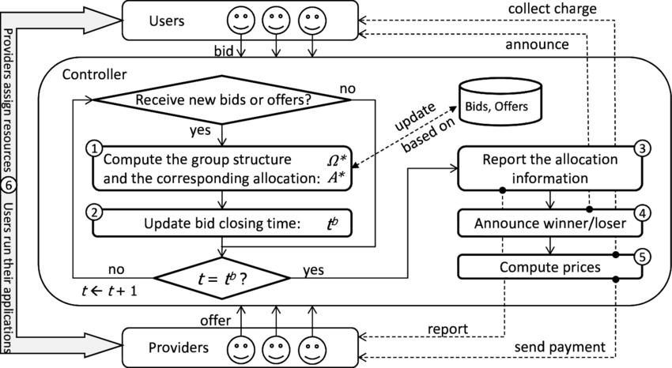
Methodology(continued…)
Fig. Data Flow Diagram

Slide 11
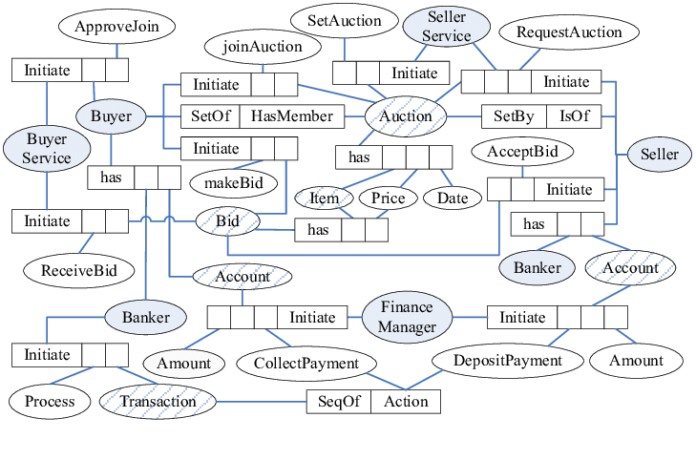
Methodology(continued…)
Fig. E.R Diagram

Slide 12
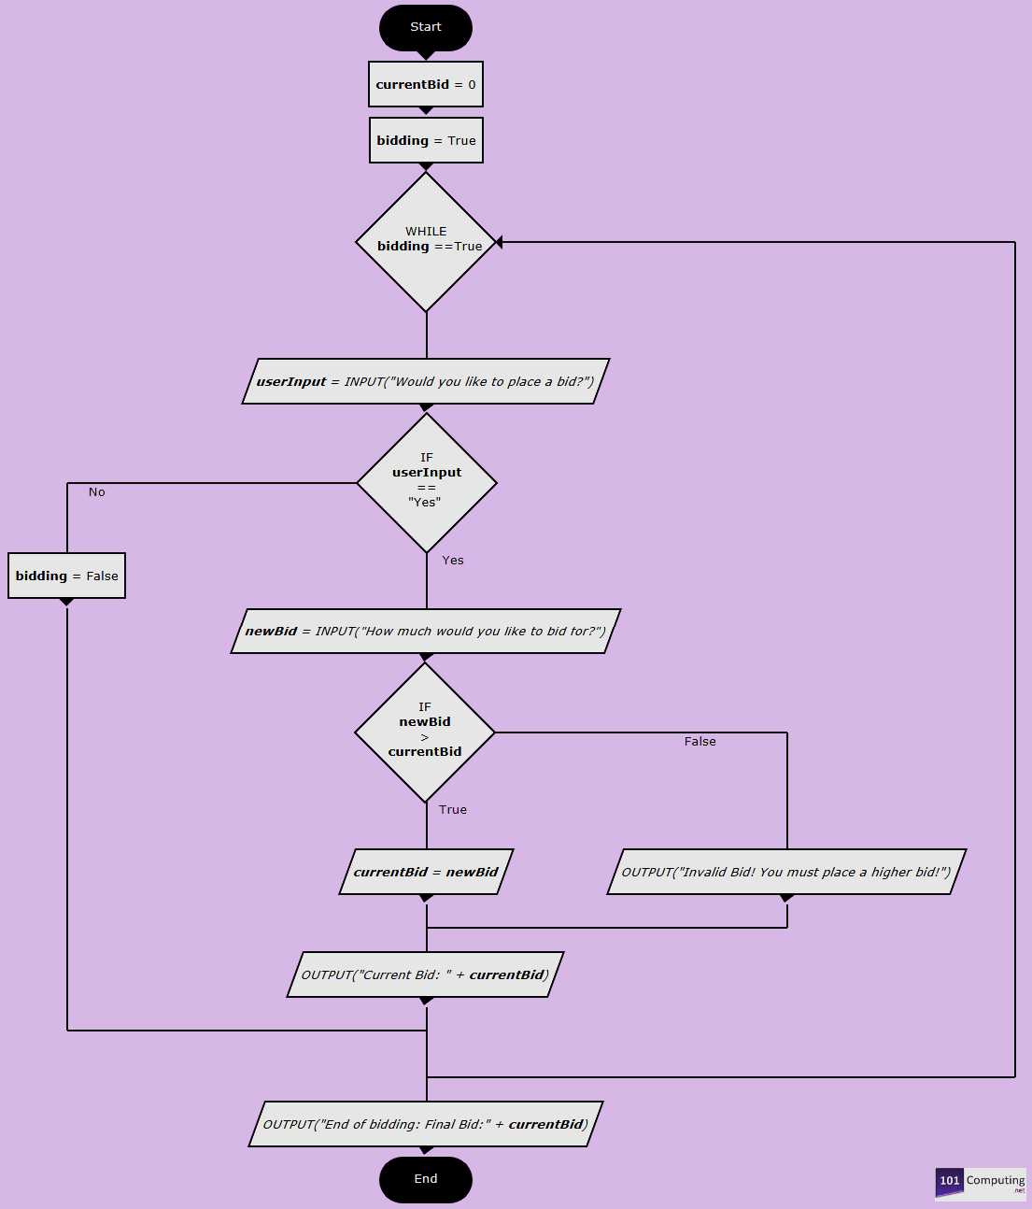
Methodology(continued…)
Fig. Flow Chart of Program

Slide 13
Tools
Hardware Requirements
Processor : PENTIUM III or above
Clock Speed : 800MHZ
System Bus : 32/64 bits
RAM : 2 GB or above
Hard disk : HDD/SSD 250GB or above
Software Requirements
Operating System : Windows/Mac OS/Linux
Browser : Any HTTP Browser
Database layer : MySQL
Frontend scripting : HTML, CSS
Backend scripting : Python (Django)
Protocol : HTTP, SMTP

Slide 14
Technology
Client-Server Architecture
Typical client-server systems are based on the 2-tiered architecture, whereby there is a clear separation between the data and the presentation/business logic.
These are generally data driven, with the application existing entirely on the client machine while the database server is deployed somewhere in the organization.

Slide 15
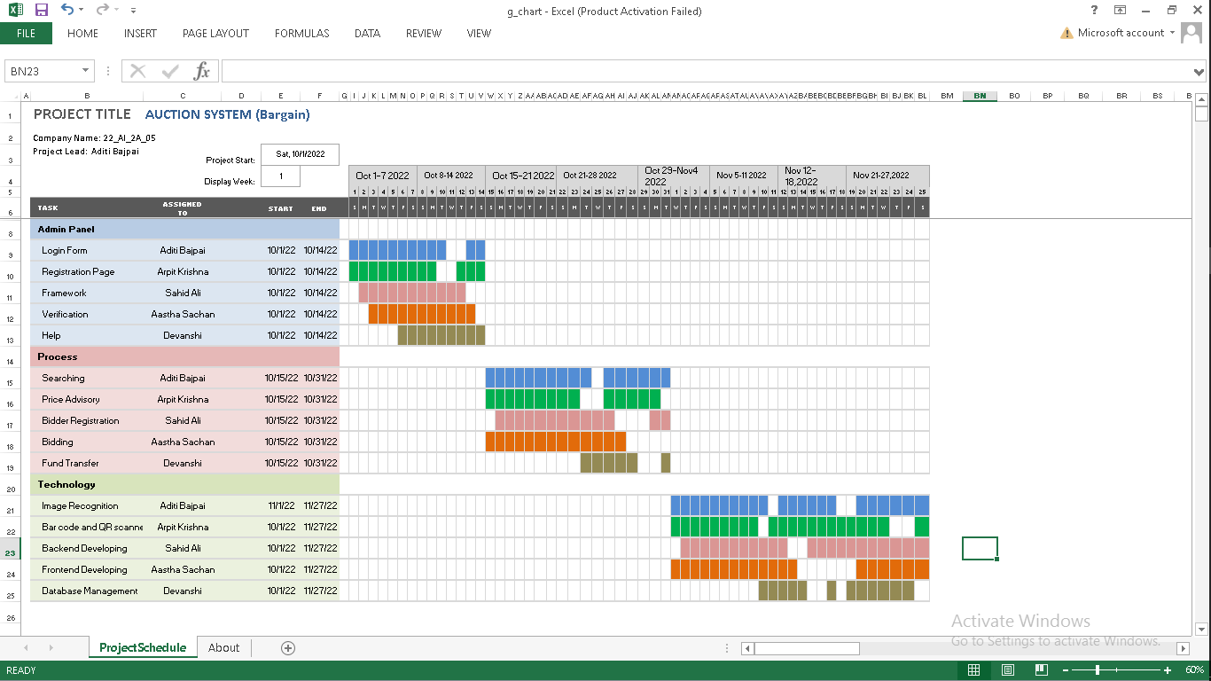
Role of team members in the project and their expertise areas.

Slide 16
Reference
http://www.google.com/
http://www.geeksforgeeks.com/
http://www.wikipedia.com/
Thanks ☺☺

